Slide 1



Stakeholder Presentation
View in Power BI
Last data refresh:
7/27/2022 7:19:27 PM UTC
Downloaded at:
7/27/2022 8:31:18 PM UTC

Slide 2
Loom
https://www.loom.com/share/f4b44efd55a74ab7ad031c1ef77df7c3

Slide 3
Prepared By
Name : Phionah Nakakeeto
College: Grand Canyon University
Course : MIS-620: Descriptive and Diagnostic Analytics
Instructor: Dr. Omari Williams
August 10, 2022

Slide 4
Discussion Points
Identify a business problem based on the data.
Summarize data considerations and assumptions.
Provide a slide for each of the dashboard visuals. Discuss an interpretation of the data and key summary points.
Identify business problems in the sales data. Discuss the root causes of these problems using the data analysis as support. Propose recommendations to executive leadership for solving the sales issues based on the data analysis.
Describe future monitoring of metrics.

Slide 5
Business Problem
The company has come to a realization that sales have gone down and this has impacted the maximization of profit. However, there’s been a discovery that some products have higher sales than the rest, and management is seeking to understand and investigate this pattern. The sales team has also received a complaint from customers that some product units are defective.
Notes:
We are trying to investigate the cause of the reduction in sales and the reason why profit margins are low.
Later slides demonstrate this problem more visually.

Slide 6
Data considerations and assumptions
We would like to know the total sales in each segment/country on an annual/monthly basis. Determine how much profit was realized from the gross sales, as well as the Profit made by each product unit. This data helps us investigate the reason why sales have reduced, and further analyze why some products have significantly higher sales than the rest.
Notes:
We are using the financial and manufacturing data sets.

Slide 7
Data considerations and assumptions
The manufacturing data helps us identify the percentage of defective product units from the total units manufactured. The assumption is that there’s a relationship between units sold and profit by both product and country.

Slide 8
Business problems in the sales data
Some products, i.e., Paseo has significantly higher total sales than the rest (outliers).
Gross sales are higher than profit which is odd.
The analysis of defective units shows that most of the products have half or almost half of their total manufactured units as defective.

Slide 9
The root causes of these problems
The analysis shows that total sales have been affected by this defect rate. This affects profit probably because the units sold are being purchased at a relatively lower price than the manufacturing price due of this same issue.

Slide 10
Recommendations to executive leadership based on the data analysis.
I would advise executive leadership to focus their attention and resources towards improving the quality of manufactured products to minimize the defect rate. This in turn should help the company gain a competitive advantage and maximize profit.

Slide 11
Future monitoring of metrics
Real-time dashboards would be used to display the data in real-time, providing IT operators and other staff members with the most up-to-date information on a variety of operational, security, and business performance metrics.
The real-time data enables executives to respond more quickly to business, security, and operational challenges.

Slide 12
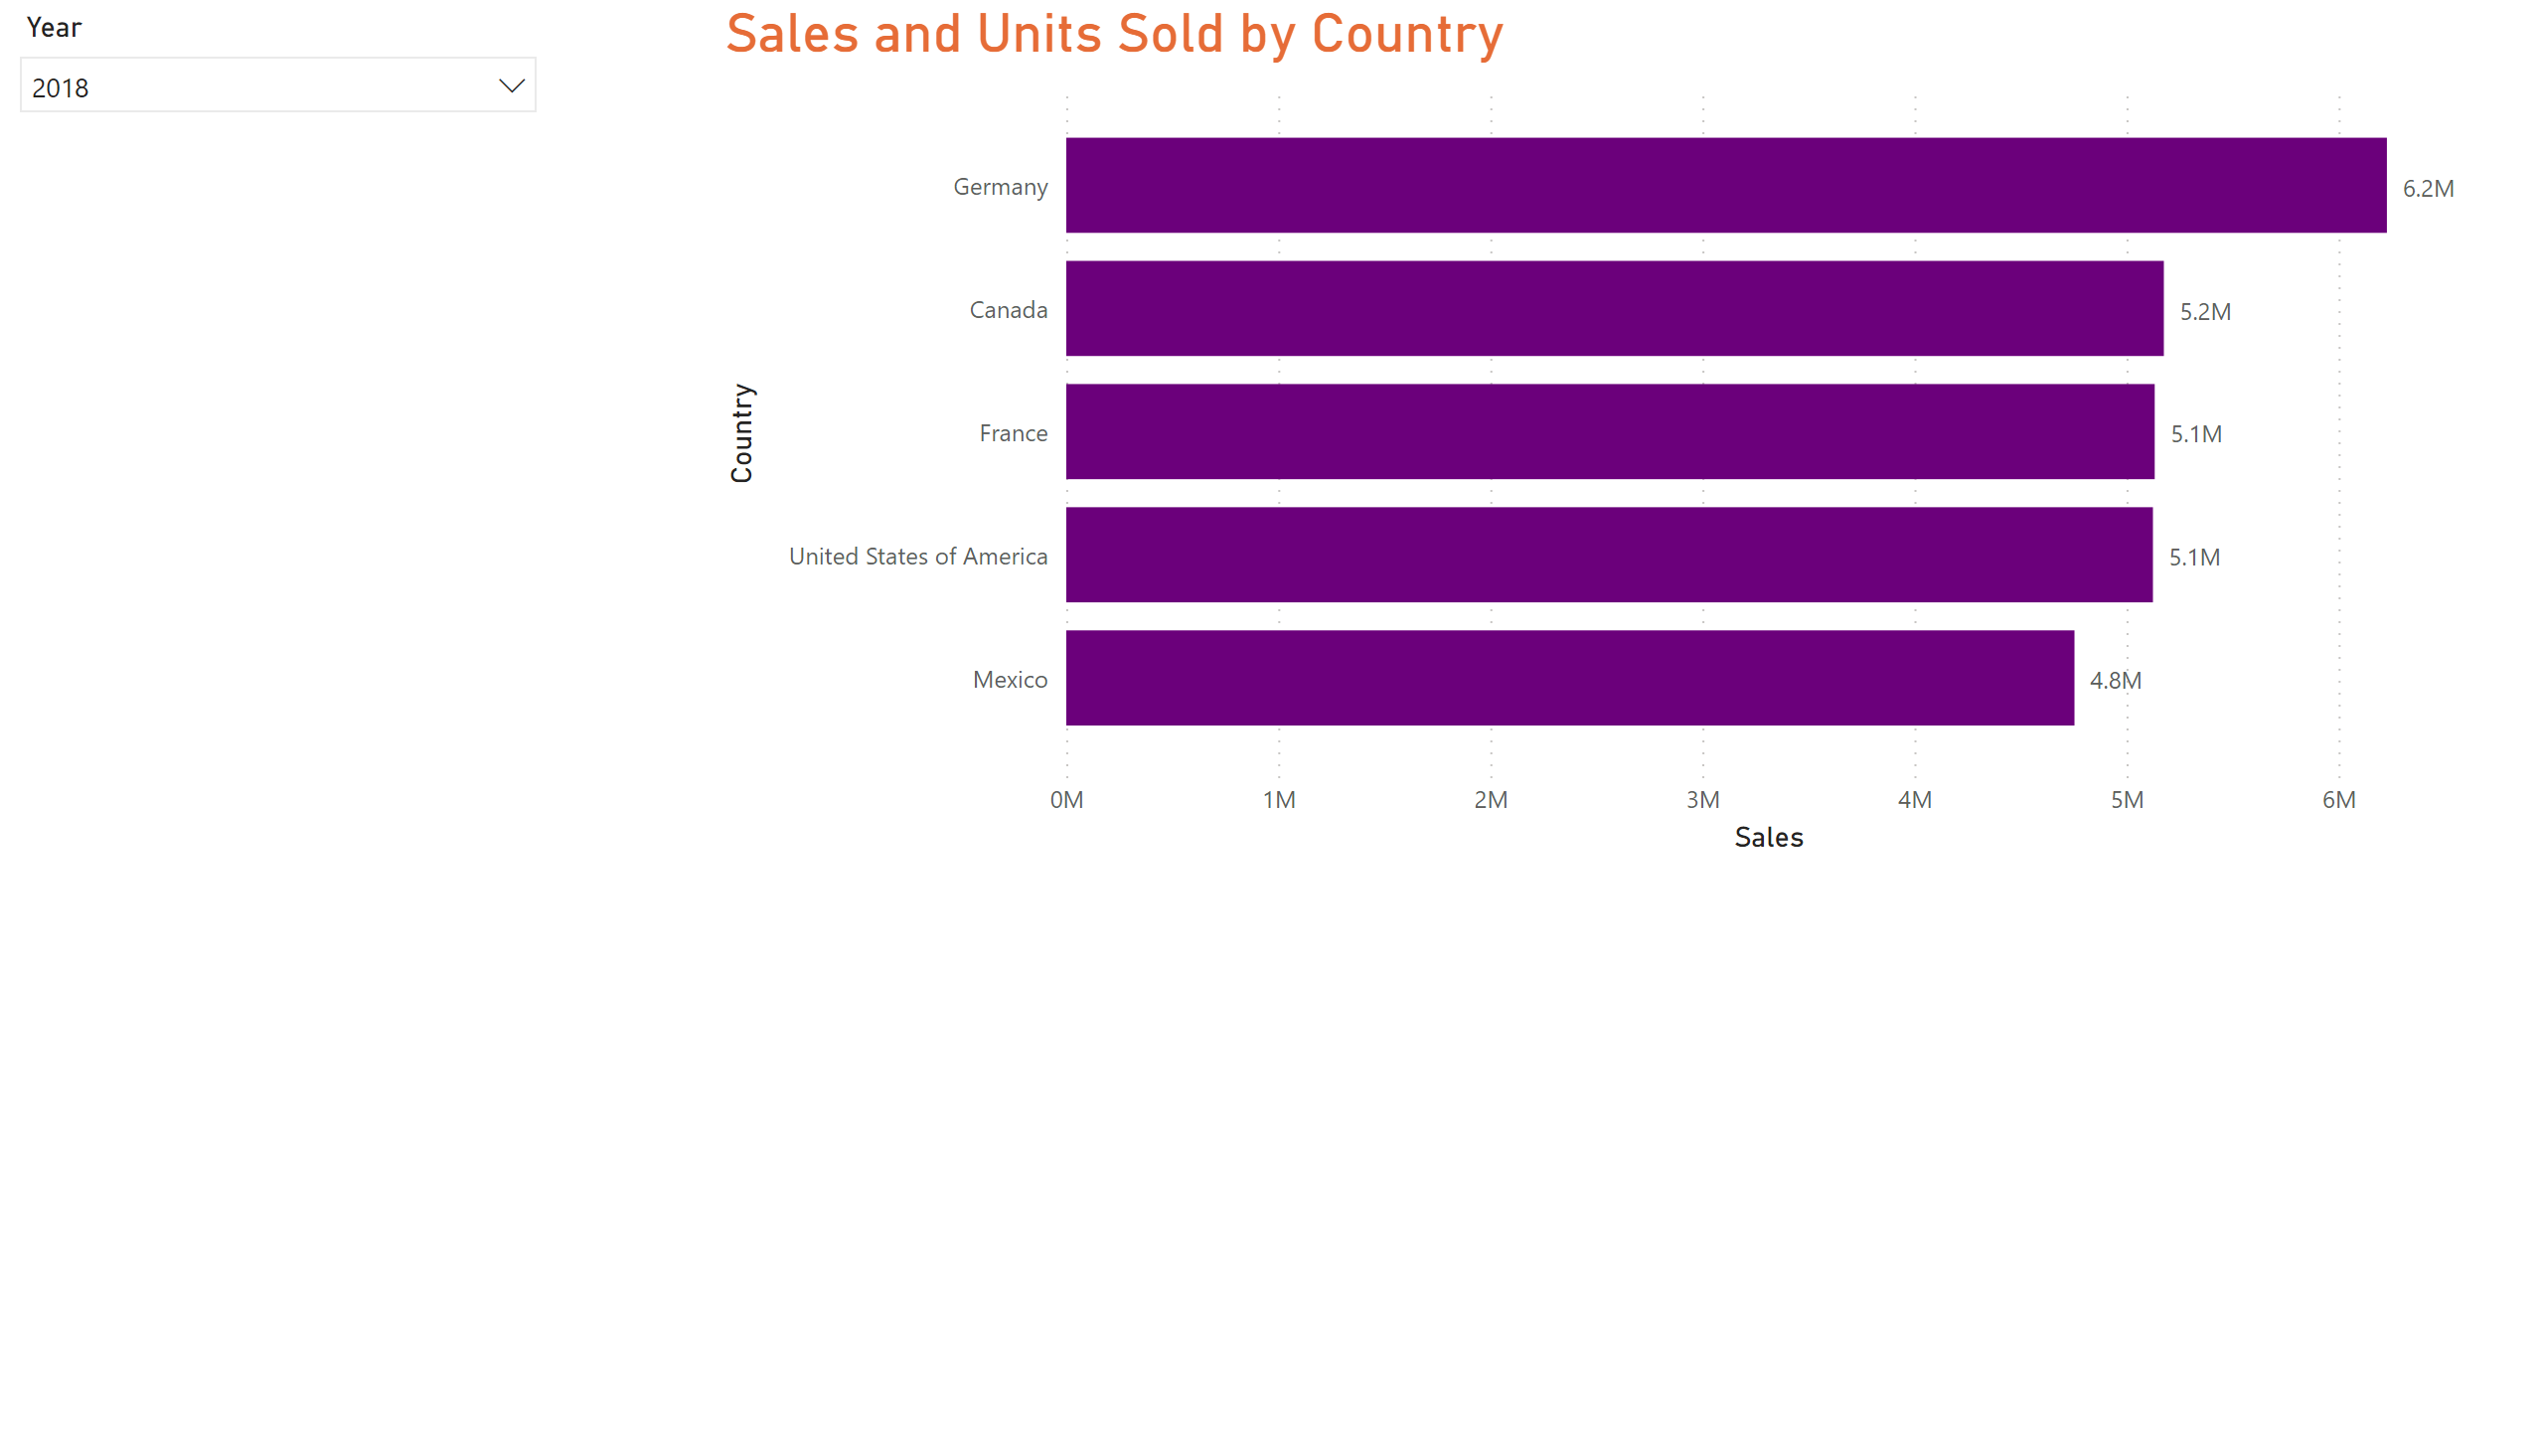
Sales By Country
Notes:
The bar chart represents total sales made in the 5 countries and the labels represent the total product units sold.
Germany has the highest total sales and units sold of the 5 countries, with Mexico depicting the lowest sales.
The slicer is used to filter this sales data based on years 2018 and 2019.

Slide 13
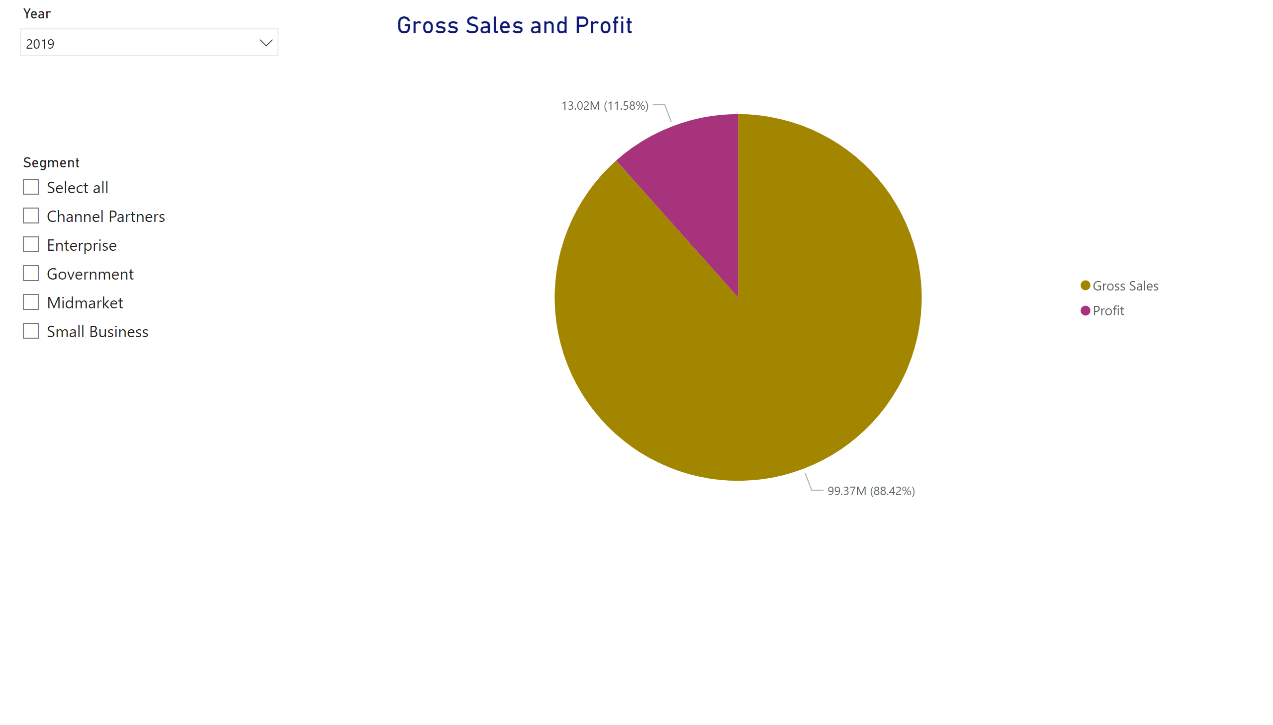
Gross sales & Profit by Segment
Notes:
The pie chart represents gross sales and total profit made by the various segments. For all the segments, gross sales seem to surpass the total profit. And for one of the segments, there was no profit at all.
This analysis symbolizes that there’s a reason why the sales are much higher than the profit.
This data can also be filtered on an annual basis i.e., 2018 and 2019 using a slicer.

Slide 14
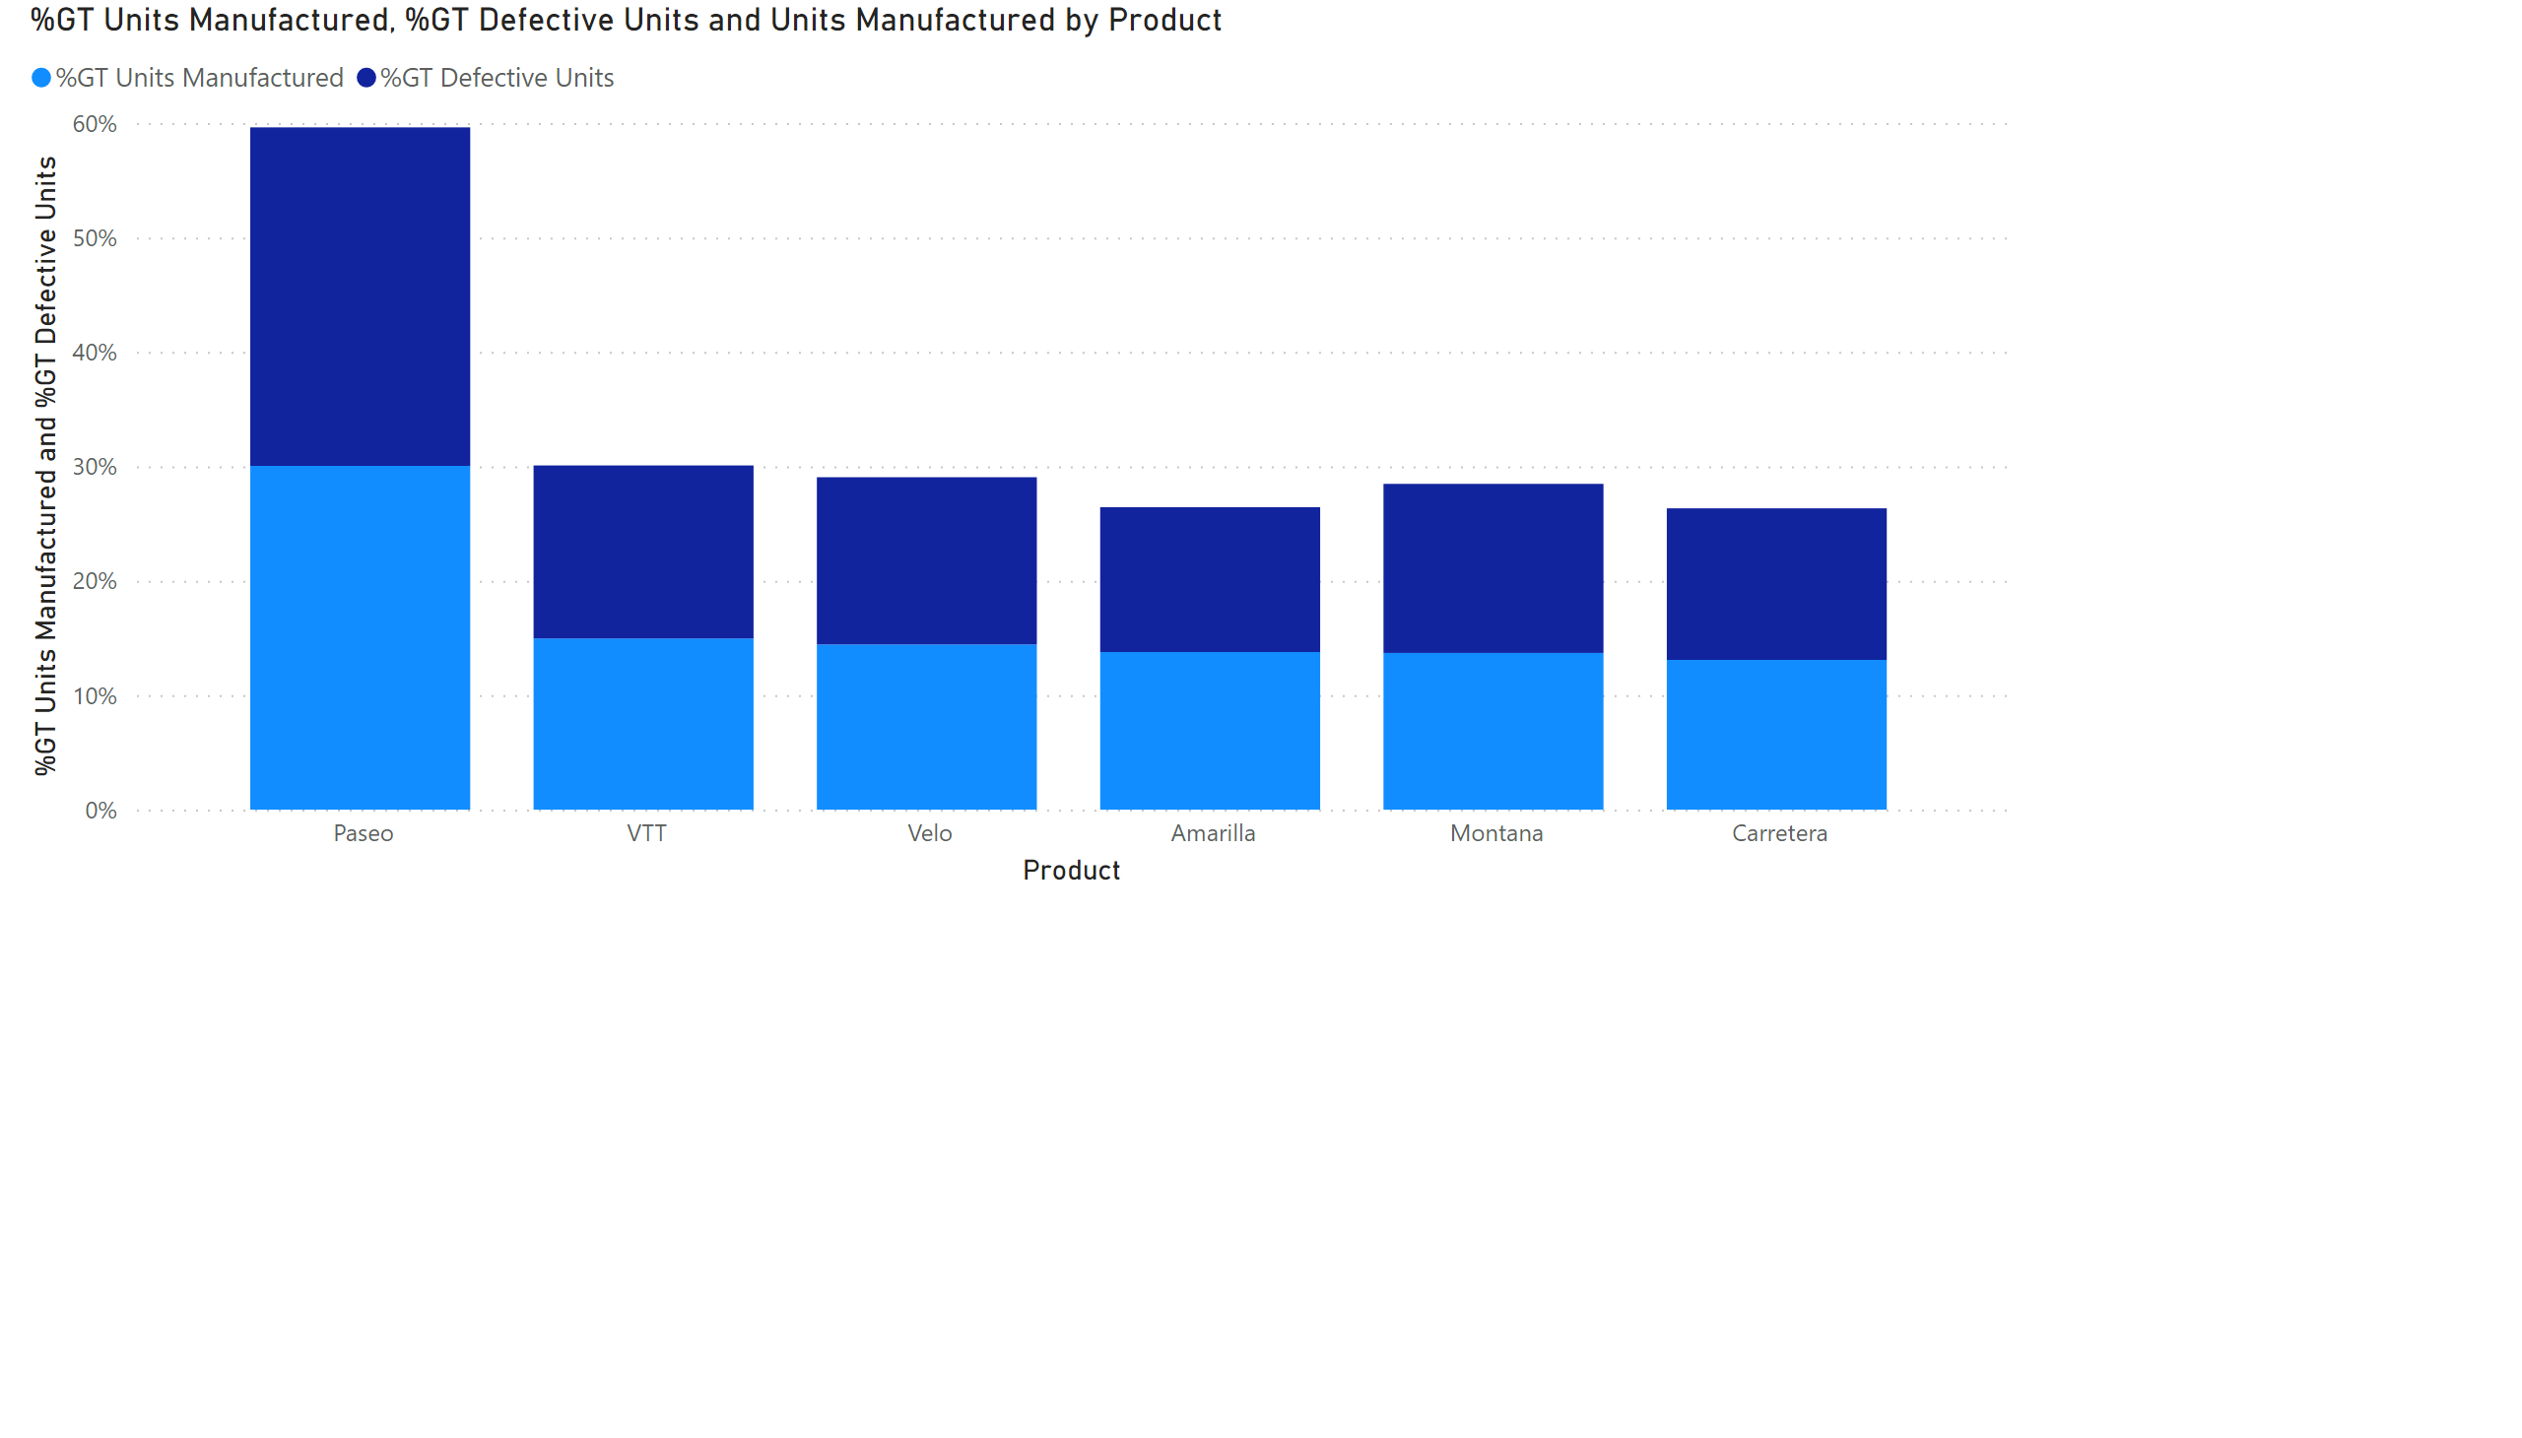
Units Manufactured & Defective Units by Product
Notes:
This stacked column chart represents the percentage of defective units from the total units manufactured. For all the products, the data shows that half the units manufactured are defective i.e., the total number of defective units is the same as the total units manufactured.

Slide 15
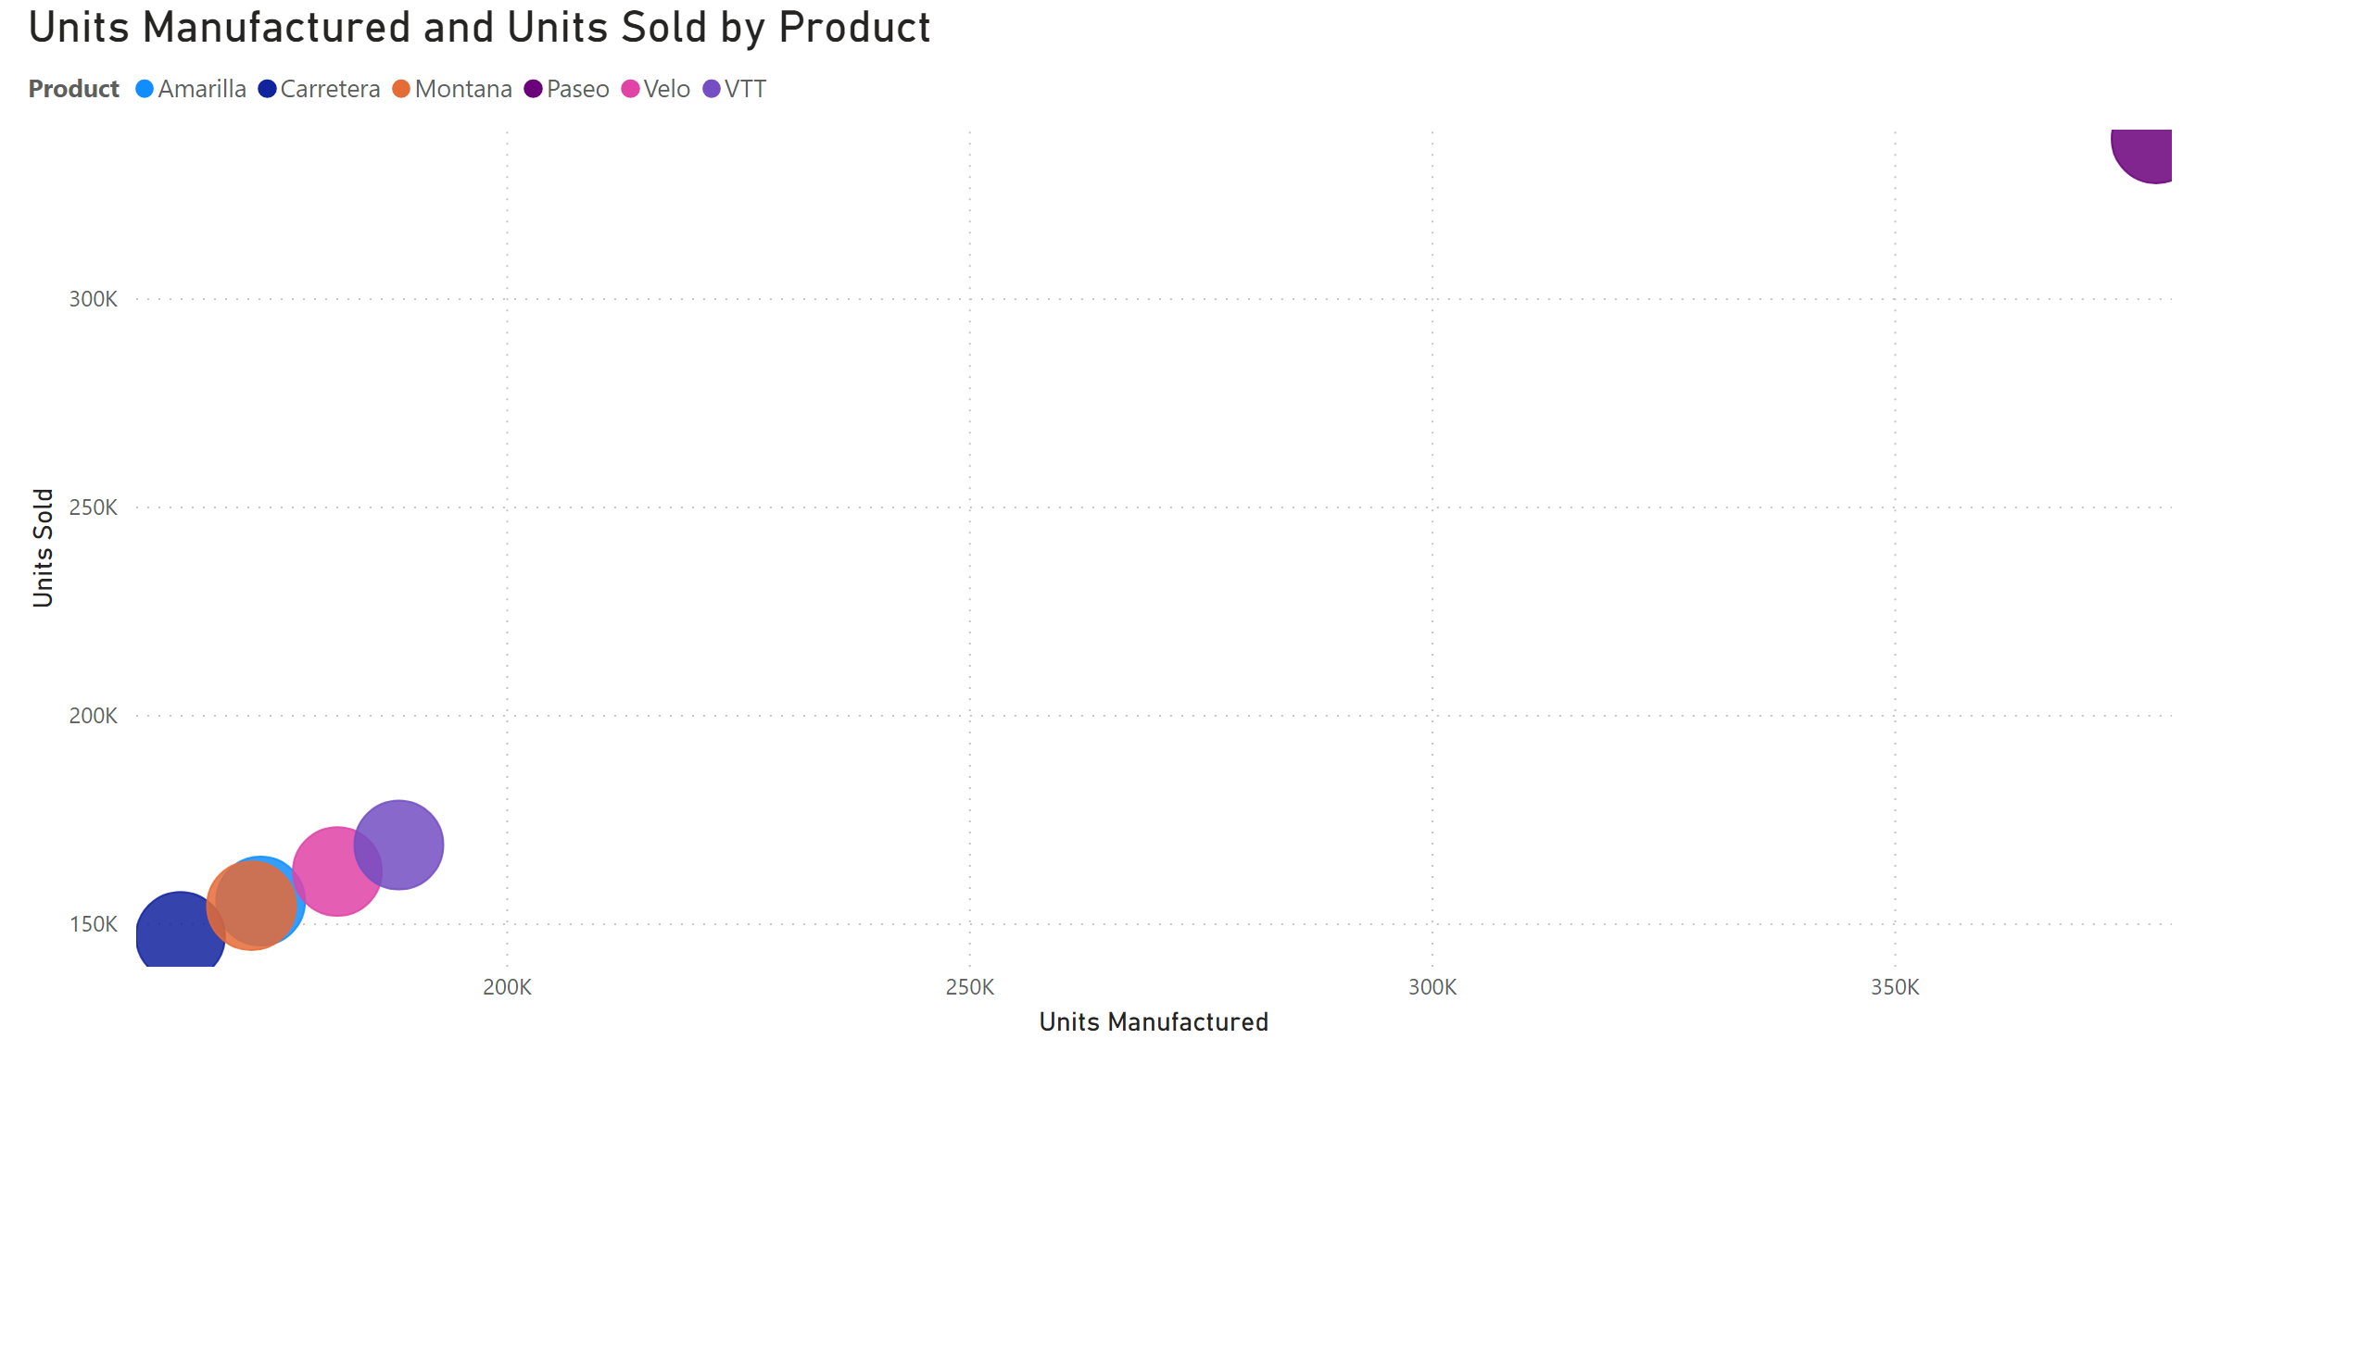
Units manufactured & Units sold Relationship
Notes:
The scatter chart represents the relationship between 2 numerical variables, units manufactured and units sold. The number of units manufactured increases with the number of units manufactured.
Also, there’s an outlier (the product Paseo) which appears to have a significantly higher total of units sold and manufactured. There should be a reason behind this discovery.

Slide 16
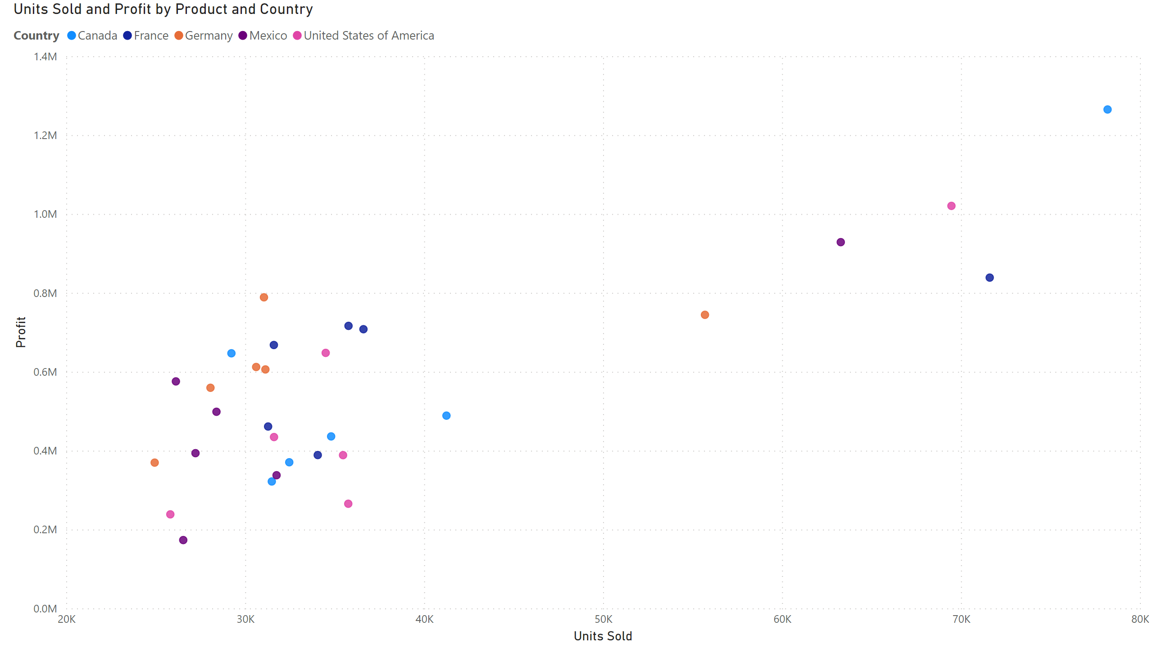
Page 9
Notes:
The scatter chart represents the relationship between units sold and profit based on product and country. The data shows that most of the products are making almost the same profit margins in all the countries except for Product Paseo which appears to be generating a significantly higher profit than the rest as well as selling more.

Slide 17
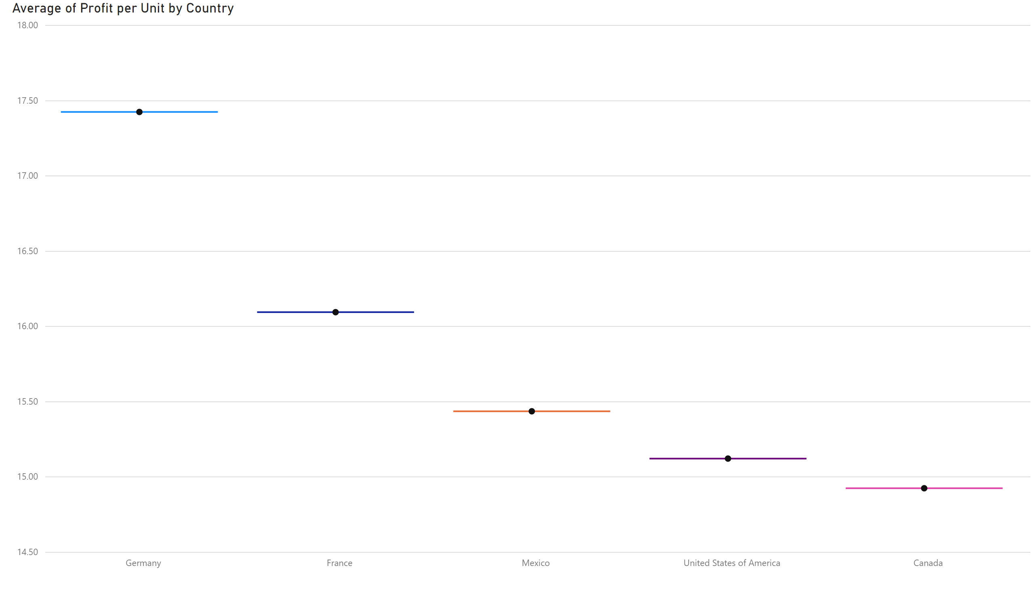
Page 11
Notes:
The box whisker chart represents the average profit made per product unit in the various countries. On average, Germany is making a higher profit than the rest of the countries.
Canada is making the lowest profit margins per unit, yet in the first bar chart, her sales are second highest to Germany with Mexico having the lowest sales. In this chart, Mexico makes a relatively higher profit per unit than Canada.

Slide 18
References
Sumo Logic. (2019, October 7). What is a real-time dashboard? https://www.sumologic.com/glossary/real-time-dashboard/

